Slide 1
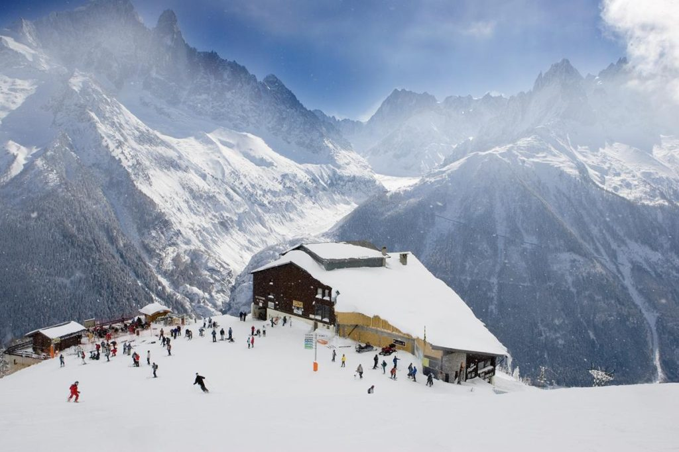
Web Scraping and Exploratory Data Analysis
North American Ski Resorts

Slide 2
In this project I have scraped data regarding top North American Ski resorts using Beautiful Soup library and requests in python.
Also the data was cleaned to be made usable for better analysis
Then I have performed my analysis on the different parameters (like elevation, annual snowfall etc.) and visualized the same using graphs.
At the end of each section I have come up with conclusions on various factors giving us more insight on how different natural conditions correlate and affect one another.
Also at the end I have also found the top 10 best resorts based on annual snowfall.

